Slide 1

Hallucinations in LLMs
汇报人：王怡丹

Slide 2


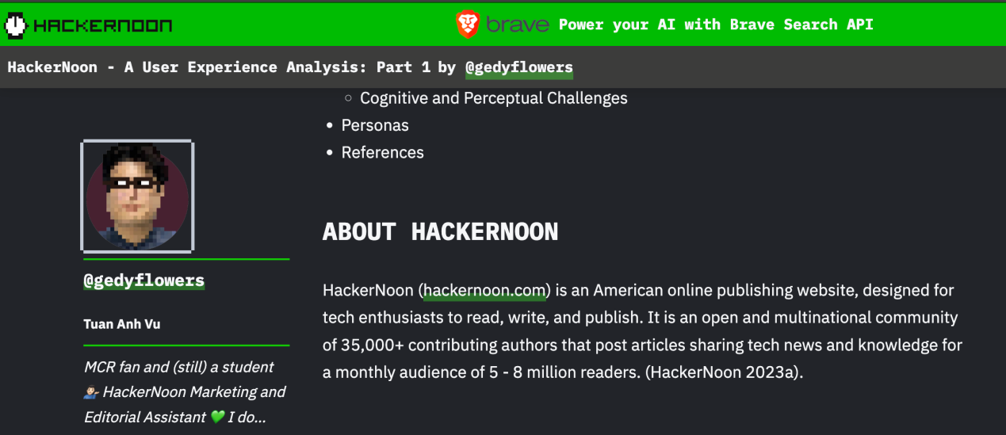



Related search engines
Academic search engine
Tech blogs and news sites
Professional forums and online forums

Slide 3
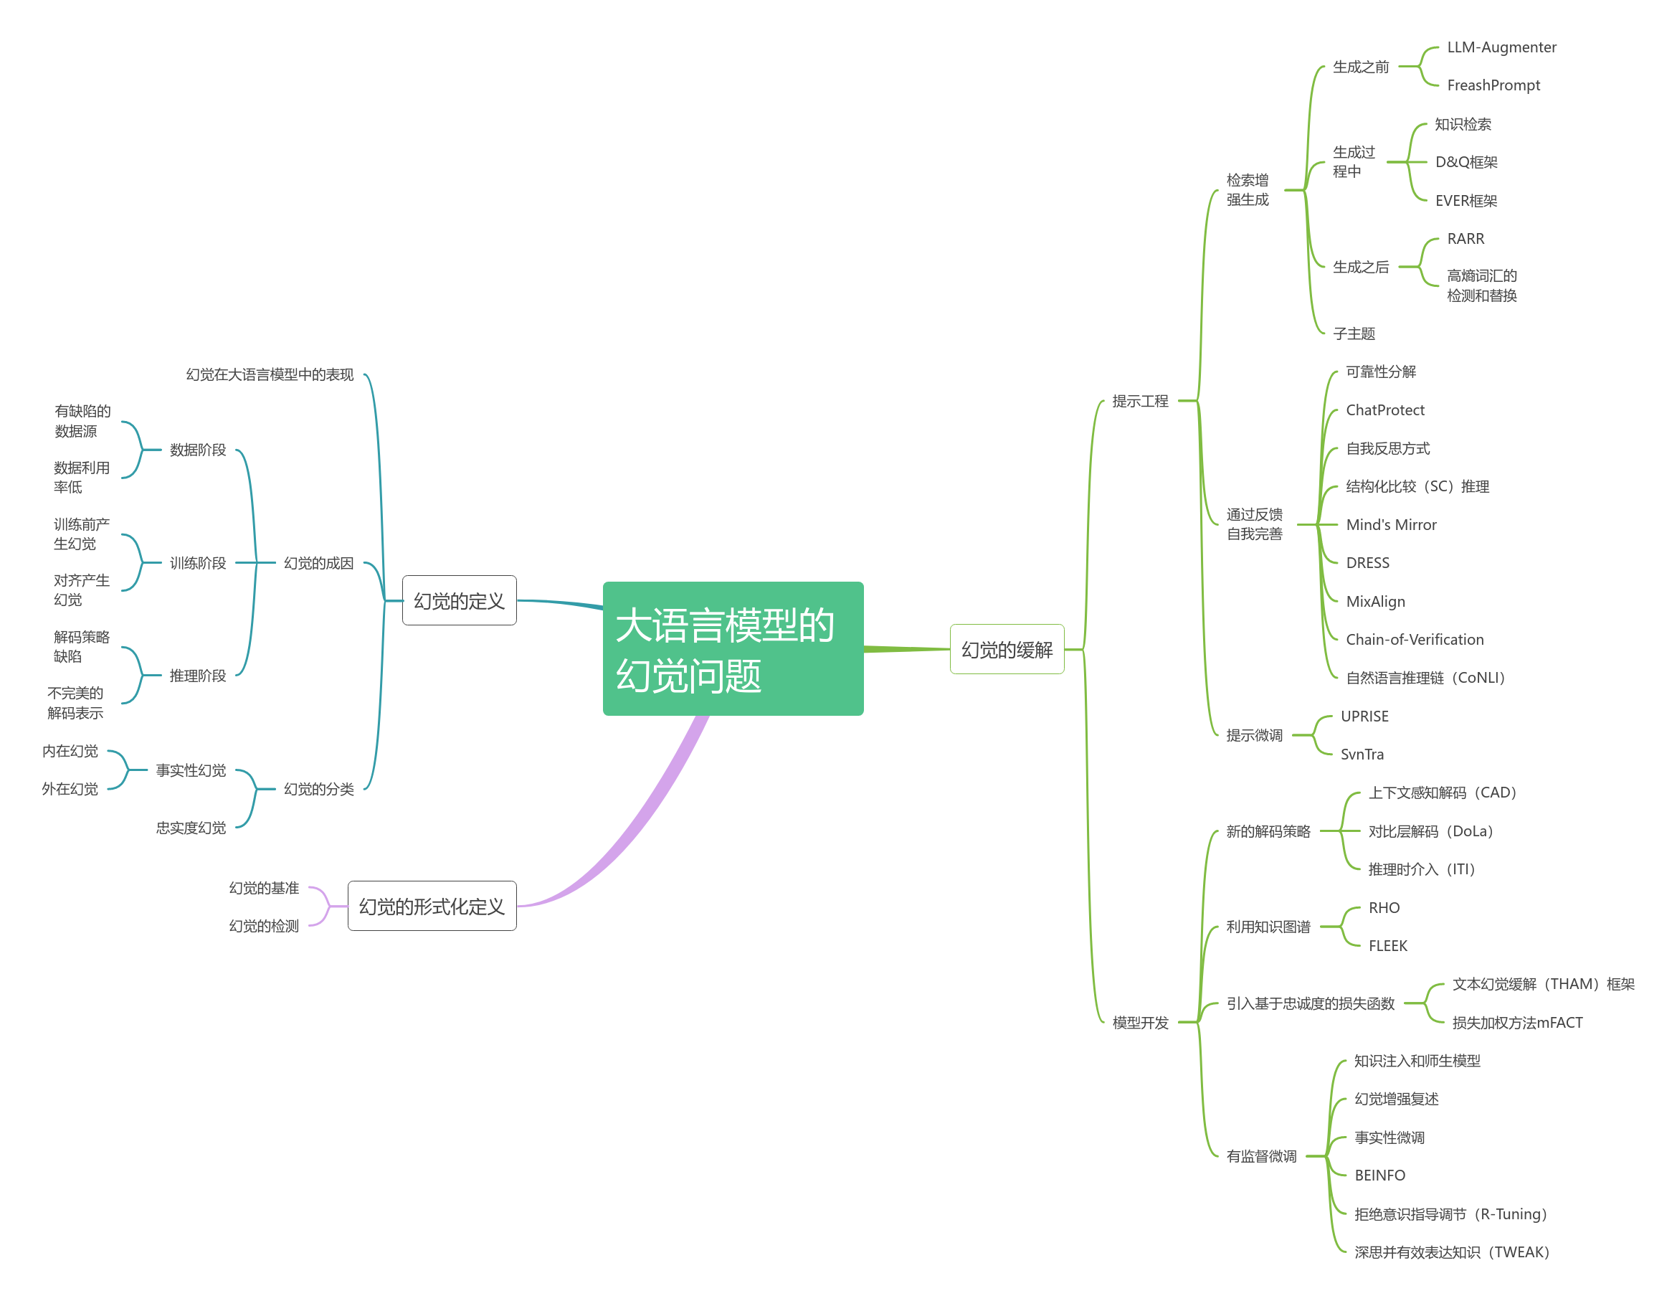
Mind Map

Slide 4
1
The definition of hallucination
2
The formal definition of hallucination
3
Alleviation of hallucinations
4
Summary

Slide 5
The definition of hallucination
壹

Slide 6
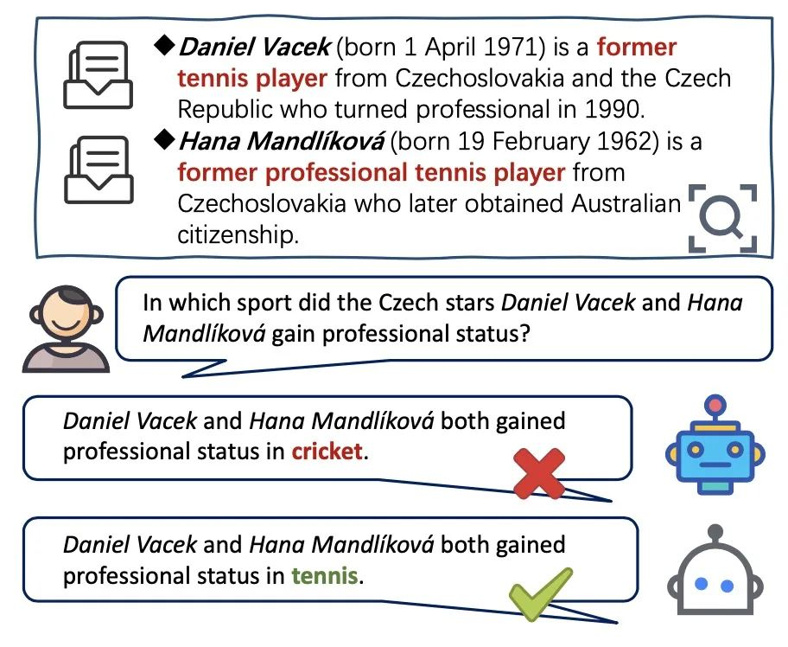
The Performance of Illusions in Large Language Models
The issue of hallucinations is a key challenge faced by large language models (LLMs), referring to the phenomenon where models generate seemingly plausible but in fact incorrect or meaningless information. This problem has raised concerns regarding safety and ethics in the context of the widespread application of LLMs, as such erroneous information could mislead users, leading to unpredictable outcomes.

Slide 7
The causes of hallucinations
Data phase
Training phase
Inference phase
1. Hallucinations generated before training
2. Hallucinations generated during alignment
1. Flaws in decoding strategy
2. Imperfect decoding representation
1. Flawed data sources
2. Low data utilization

Slide 8
fidelity hallucinations
Considered based on user instructions, including directive inconsistencies, contextual discrepancies, and logical inconsistencies.
factual hallucinations
Intrinsic hallucinations occur when the output of an LLM contradicts the provided input.
Extrinsic hallucinations refer to outputs that cannot be verified through input information.

Slide 9
The formalization of hallucinations
贰

Slide 10
Analyzing hallucinations in a formalized way
The term "hallucination" remains abstract and difficult to quantify. In the real world, due to the complexity of the models' inputs and outputs, it is challenging to define what constitutes a hallucination. The most common description is that hallucinations are outputs that do not conform to reality.
Then what is reality, and when do inconsistencies arise? These questions require further discussion based on the complex inputs and outputs.
We need to abandon the complex definitions of "correctness" in the real world and instead turn to a formalized world, defining hallucinations mathematically.
98%

Slide 11
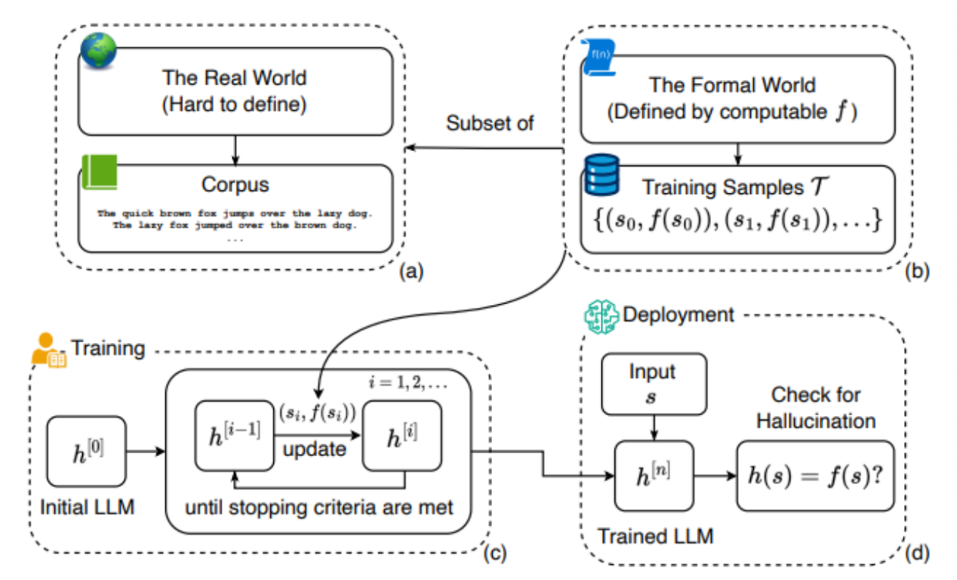
The benchmark for hallucinations
From the model, corpus, and training deployment process, a schematic diagram of the formal definitions and relationships of all relevant concepts.

Slide 12
Mitigating hallucinations
叁

Slide 13
Two principles for alleviating hallucinations
Based on the occurrence of hallucinations, we can define two principles for relieving hallucinations
(a) Improving language modeling capabilities
Theoretical thinking
(b) A real function f that provides the language model with more information about the real world, by using training samples or inductive biases.
a. Larger models and more training data
b. Guide LLM with thought chain/reflection/validation
This approach will not only alleviate the illusion problem of large language models, but in general they will improve the power and security of large language models

Slide 14
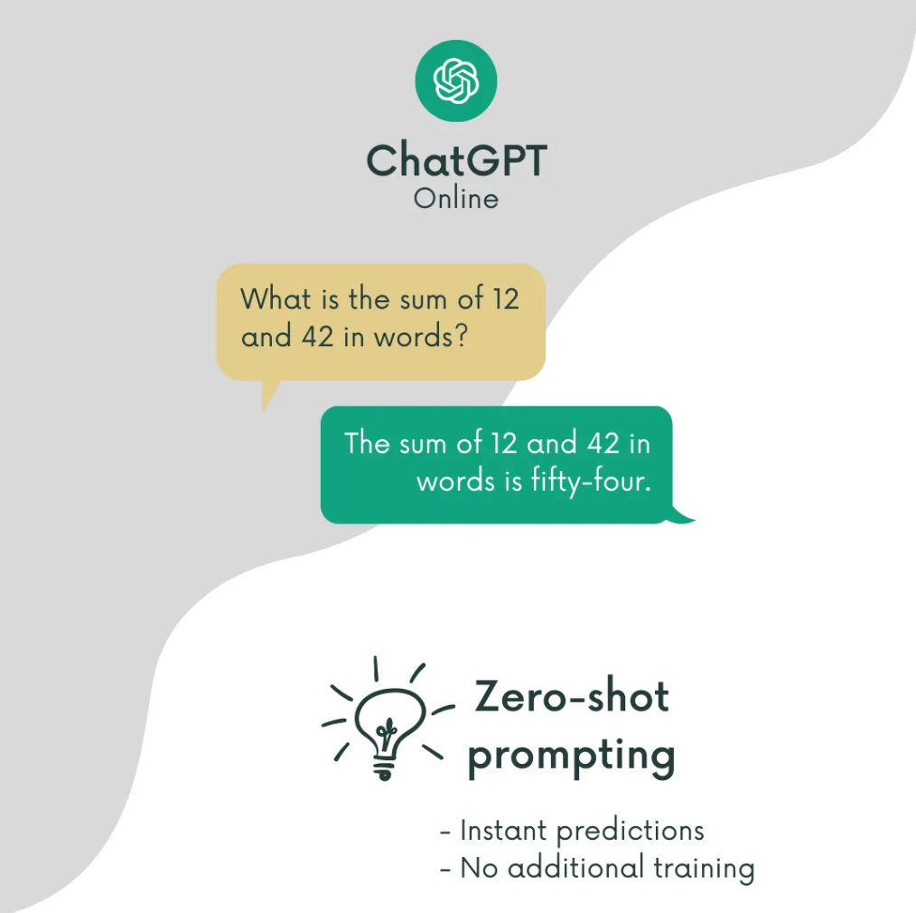
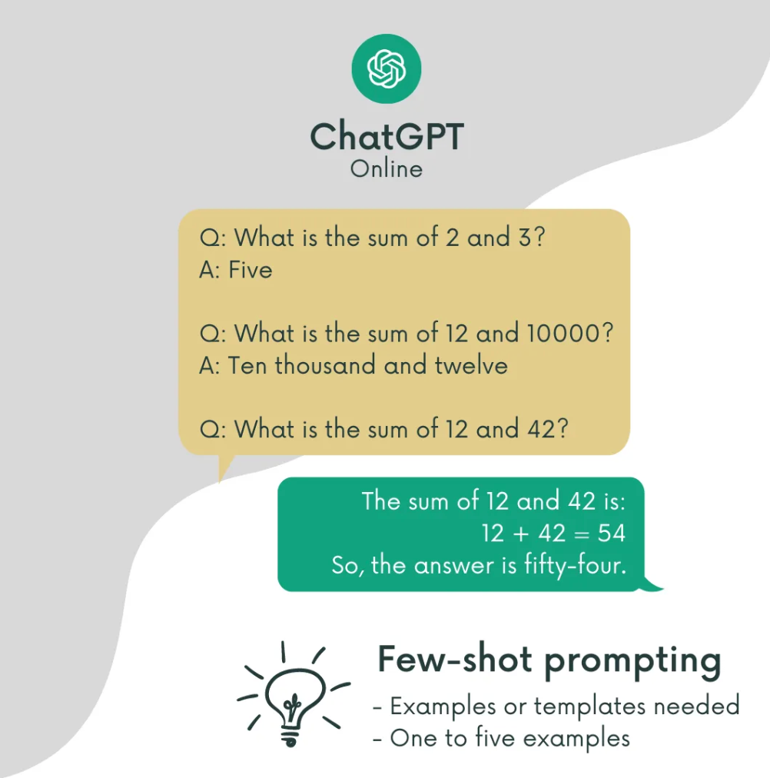
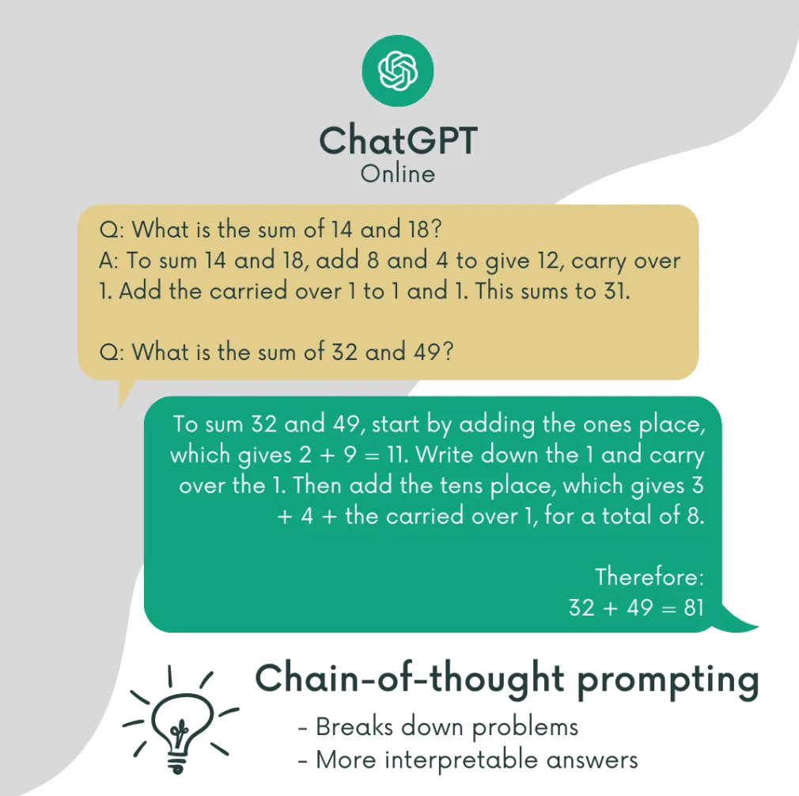
Chain-of-Thought
The idea is to teach the computer to learn from context, such as by showing it correct examples or relevant knowledge. The goal is for computers to think like humans and find simple and effective ways to solve problems.
Giving the computer some tips to guide it to learn simple ways of human tendencies can reduce the number of cases in which the computer makes mistakes. However, this method is not a panacea, and it only works for certain problems.
a. No intermediate thought process prompts
b. A few thought process prompts
c. Prompt in the way of thinking chain

Slide 15
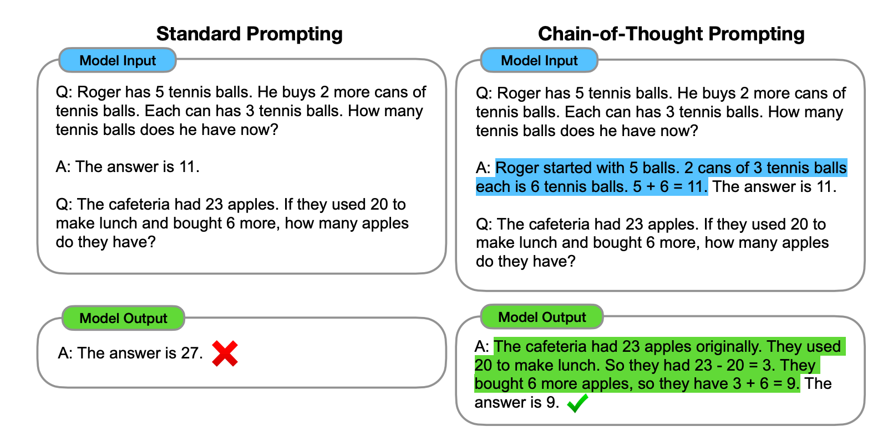

Slide 16
reflection
self-Reflection
In reflective strategies, models are encouraged to self-evaluate and think critically after generating answers. The model reflects on its initial answer or reasoning, explores possible errors, and considers other possible explanations or answers. This process may involve examining the plausibility of the answer, possible logical holes, or assessing the level of confidence in the answer. This can be done by training models to identify and resolve uncertainties and contradictions in their own reasoning.
Network
Talk
Photos
Location

Slide 17
verify
Verification
1
2
Validation strategy
Large language model
Validation strategy is about the model fact-checking or evidence finding after it gives an answer to ensure the accuracy of its response. In this strategy, the model may seek out additional information to support its answer, or reconsider the problem to validate its previous reasoning.
For a complete large language model generation chain, all three strategies aim to promote deep understanding and precise reasoning of the model in different ways. Chain of Thought focuses on demonstrating the problem-solving process, Reflection focuses on critically evaluating and improving the reasoning process, and validation focuses on ensuring the accuracy and reliability of answers

Slide 18
LLM integration
Use several language models to solve the same problem together. The models talk to each other and then vote or agree on the answer
Due to its unique architecture, api, and compatibility requirements, it can be a time-consuming and challenging task
The application of principles to language models to ensure that their outputs conform to human values, ethics, and legal requirements. The "fence" refers to the list of critical tasks that should never be completely automated by the language model.
Fences and fences
Utilize external knowledge sources (such as knowledge graphs and databases) and symbolic reasoning methods (such as logical assistive language models). Explicitly control the workflow of the language model by changing the way information is extracted (through retrieval from knowledge databases) or by logical inference.
In this way, language models gain additional information about real functions in addition to training data, and thus may be an effective way to mitigate illusions in the formal world
Language model of knowledge enhancement

Slide 19
The combination of knowledge graph and LLM
The combination of knowledge graph and LLM
Specifically, the LLM memorizes the facts and knowledge contained in the training corpus. However, further research has shown that LLMS are unable to recall facts and often also suffer from hallucination problems, i.e., producing statements with false facts.
01
Potential problems with the LLM model
The LLM is a black box model and lacks explainability, which has been criticized. LLM implicitly represents knowledge through parameters, and it is difficult for us to interpret and verify the knowledge obtained by LLM. In addition, LLM performs inference through probabilistic models, which is a non-decisive process. Details and explanations of the specific patterns and functions that LLMS use to make predictions and decisions are not readily available.
02
Although some LLMS have the ability to interpret their own predictions, the explanations they deduce are still illusory. This can seriously affect the use of LLM in high-stakes scenarios.

Slide 20
LLMS trained on general corpora may not generalize well to specific domains or new knowledge due to lack of domain-specific knowledge or new training data. To address the above issues, one potential solution is to integrate knowledge graph (KG) into LLM
The knowledge graph can actively evolve with the continuous input of new knowledge
Knowledge graphs can store a large number of facts in the form of triples
Knowledge graph has great symbolic reasoning ability
In addition, by having experts build domain-specific knowledge maps, you have the ability to provide accurate and reliable domain-specific knowledge

Slide 21
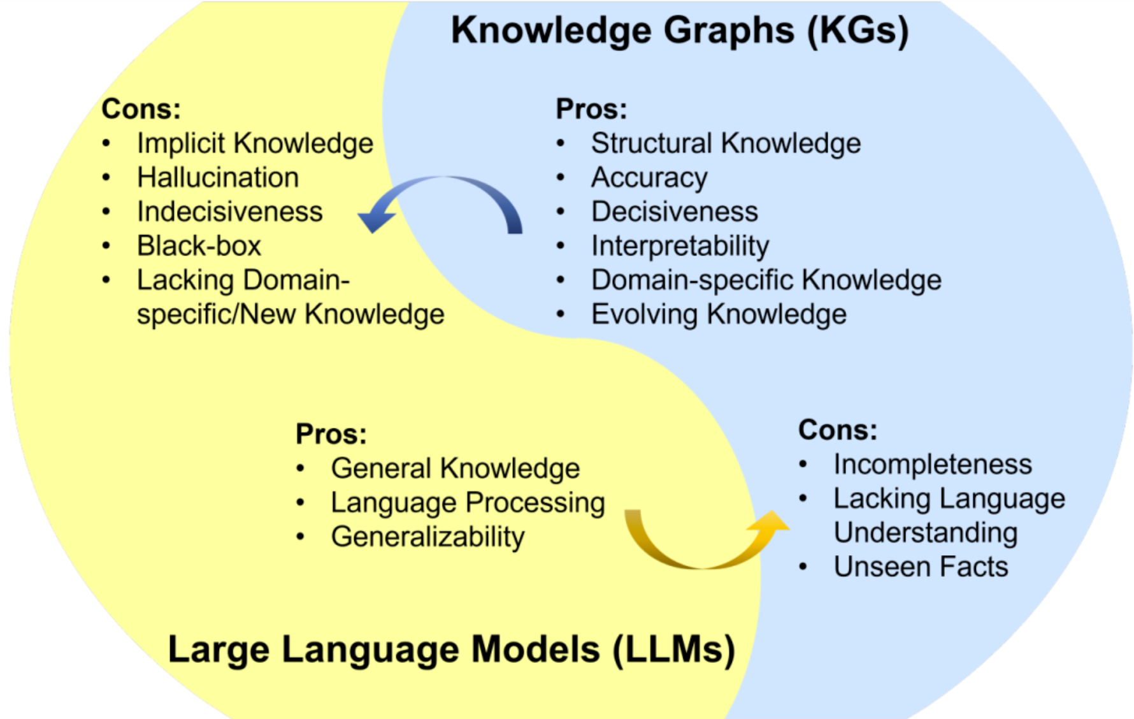
However, knowledge graphs are difficult to construct, and because real-world knowledge graphs are often incomplete and dynamically changing, current knowledge graph methods are difficult to cope with. These methods cannot effectively model unseen entities and represent new knowledge. In addition, the wealth of text information in the knowledge graph is often overlooked. Moreover, the existing methods of knowledge graph are often customized for specific knowledge graph or task, and the generalization ability is insufficient. Therefore, it is necessary to use LLM to solve the challenges facing the knowledge graph.

Slide 22
LLM and Knowledge graph
LLM and Knowledge graph
Knowledge graph
Advantages of LLM:
General knowledge, language processing, generalization ability
LLM
Advantages of knowledge graph:
Structured knowledge, accuracy, decisiveness, interpretability, domain-specific knowledge, knowledge evolution.
Knowledge graph
Disadvantages of LLM:
Implicit knowledge, illusion problems, indecisiveness problems, black boxes, lack of domain specific knowledge and new knowledge.
LLM
Disadvantages of knowledge graph:
Incompleteness, lack of language understanding, unseen knowledge.

Slide 23
If an LLM is enhanced with a knowledge graph, the knowledge graph can not only be integrated into the pre-training and inference phases of the LLM to provide external knowledge, but can also be used to analyze the LLM to provide interpretability
In terms of using LLM to enhance knowledge graph, LLM has been used in a variety of applications related to knowledge graph, such as knowledge graph embedding, knowledge graph completion, knowledge graph construction, knowledge graph to text generation, and knowledge graph question answering. LLM can improve the performance of knowledge graph and facilitate its application.
LLM and knowledge graph are intrinsically interrelated and can reinforce each other

Slide 24
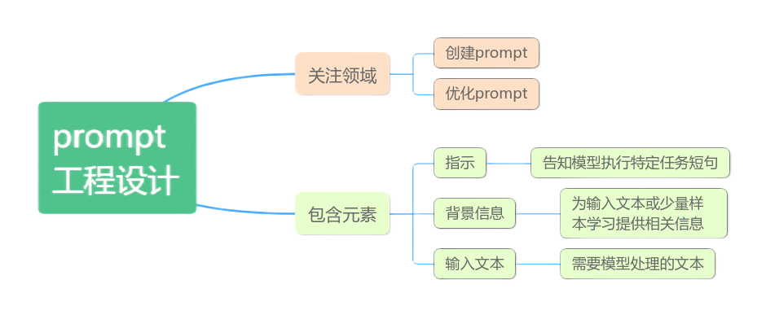
Most LLMS are derived from the Transformer design, which includes encoder and decoder modules and uses a self-attention mechanism.
So we're introducing new territory

Slide 25
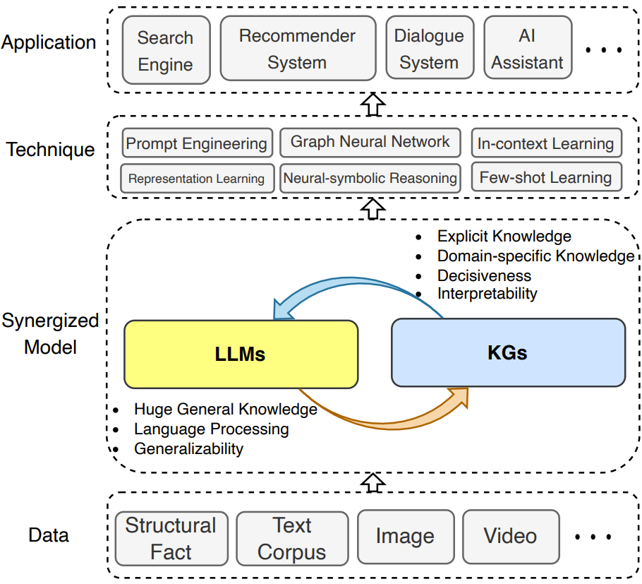
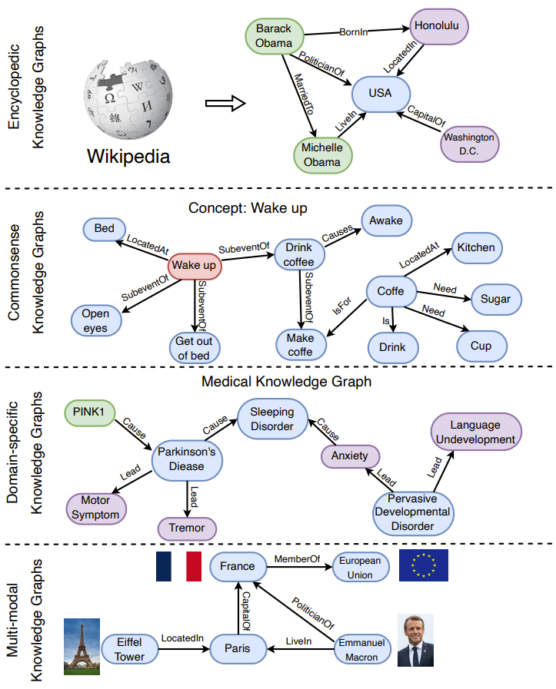
The existing knowledge graph can be divided into four categories: encyclopedic knowledge graph, general knowledge graph, domain-specific knowledge graph and multimodal knowledge graph.
However, whether it will be scalable for real-world tasks remains an open question.
LLM is a general framework for collaboration with knowledge graph, which contains four layers: data, collaboration model, technology, and application.

Slide 26
Efficient inheritance algorithm
Efficient inheritance algorithm
Direct embedding
01
Then the content of knowledge graph or database is taken as part of the model training data
Retrieval - enhancement model
02
Before the response is generated, the relevant information is first retrieved from the external knowledge base. This requires the model to have a certain retrieval ability to find and integrate relevant information from external knowledge sources according to a given query or context
Symbolic reasoning integration
03
By integrating symbolic reasoning, such as logical reasoning, into the model, it enables the model to make more complex and accurate reasoning using external knowledge.
04
Neural symbol integration
Combine the best of both worlds: the ability of neural networks to process large-scale data and learn complex patterns, and the advantages of symbolic logic for precise reasoning.

Slide 27
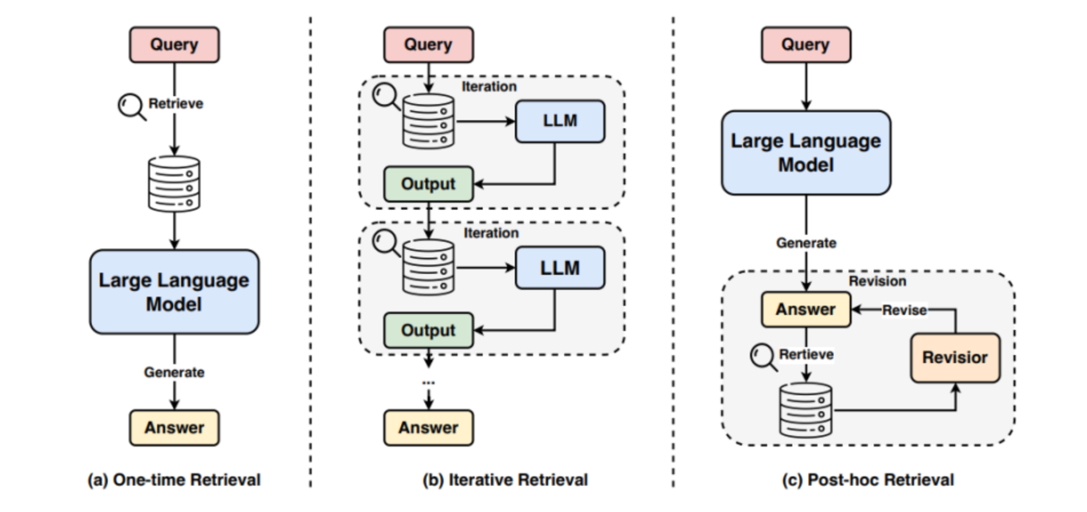
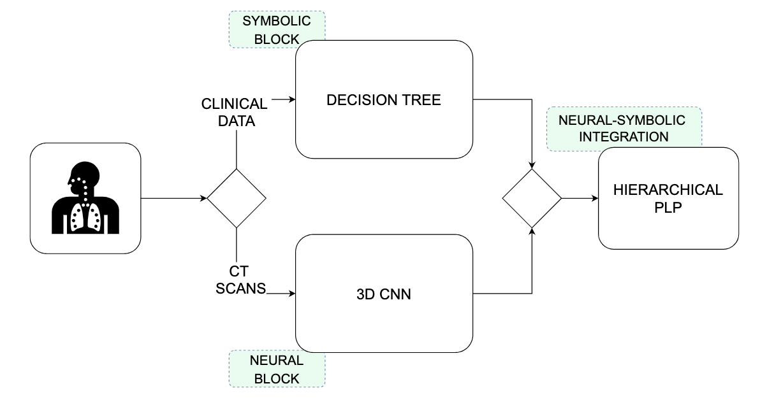
Retrieval - enhancement model
The stages and methods of search are divided into the following three types
Neural symbol integration
An example of an article on the convergence of medicine and deep learning
Neural-Symbolic Integra-tion system: DT and 3D-CNNare integrated using HPP

Slide 28
Summary of decision system framework of neural networks and symbolic logic
Overall, the system design reflects a hybrid approach that combines deep learning (for image processing and feature extraction) and symbolic reasoning (for structured data analysis and logical decision making). The goal of neural symbol integration is to use the advantages of both to improve the performance and interpretation of the model. In the case of medical diagnostics, this integrated approach helps to improve the accuracy of decision making and may provide better interpretability, which is important for medical professionals to understand the diagnosis and treatment plan recommended by the model.

Slide 29
peroration
肆

Slide 30

结语
peroration
The ultimate goal of training large language models is to make them think like a human, and this property can be summed up in one sentence: generalization is intelligence. For the broader application scenarios of large language models, the dialogue function of the APP version, which is currently popular, also needs to be combined with the field of human-computer interaction and reinforcement learning to achieve better intelligence in the future.

Slide 31
Team member information introduction
This member’s information
王怡丹
陈钰琴
资料查找&撰写
演讲
ppt制作

Slide 32
THANKS

